Slide 1

Prepared by Mahmoud Khaled & Abdelrahman Hossam
Sales Performance Dashboard Overview
Summary & Insights

Slide 2
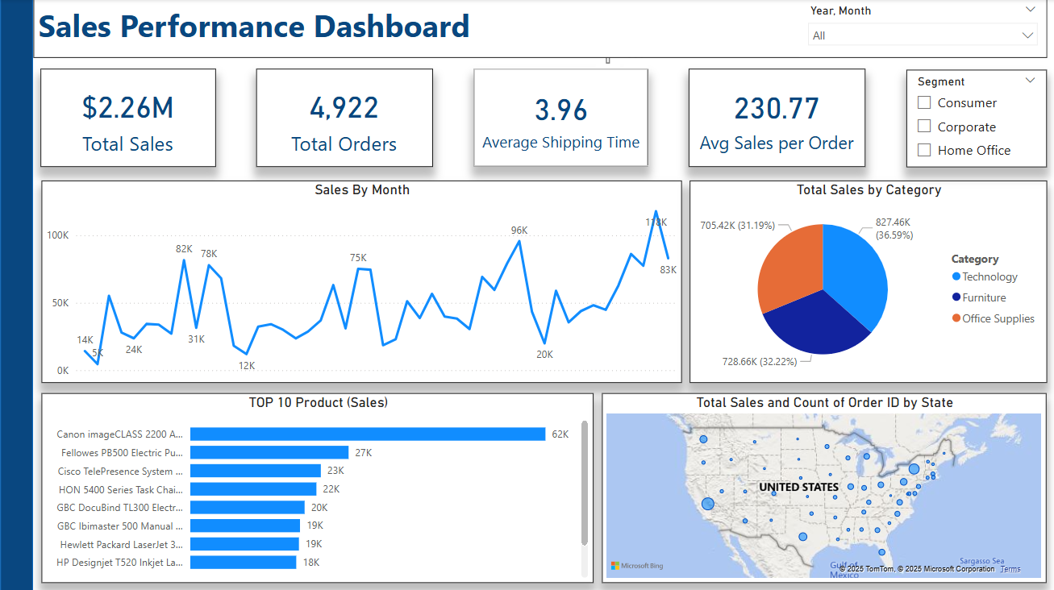
Summary
Main KPI’s
Total Sales: $2.26M
Total Orders: 4,922
Average Shipping Time: 3.96 days
Avg Sales per Order: $230.77

Slide 3


Sales Performance Analysis
Monthly Sales Performance
Insights:
Consistent growth overall
Peaks at $96K & $118K

Slide 4

Sales Breakdown by Category
Sales by Product Category
The total sales are split to 3 categories:
Technology: 36.59%
Furniture: 32.22%
Office Supplies: 31.19%

Slide 5
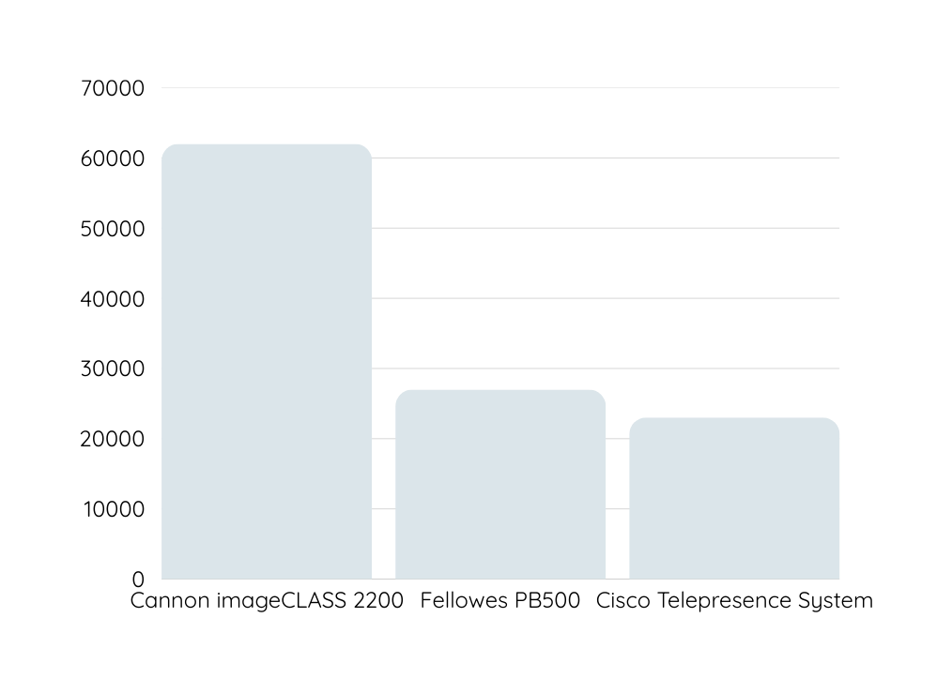
Top Performing Products
Our top 3 best performing products are:
Product #1: Canon imageCLASS 2200
Product #2: Fellows PB500
Product #3: Cisco Telepresence System

Slide 6
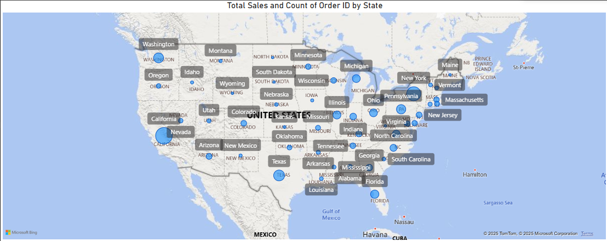
Sales by Geography
Sales Distribution Across States
Insight:
There is presence across all states
Concentrations in California, Texas, and New York.

Slide 7
Key Takeaways
Growth trend is strong, especially toward the end of the period.
Technology leads sales categories.
Canon imageCLASS 2200 Advanced is a top driver.
Geographic focus can help optimize future campaigns.
Recommendations
Focus on high-performing categories and products.
Explore marketing strategies in top-performing states.

Slide 8
Thank you

